Slide 1
AMS_LABEL BOOK GUIDE
Employee name: 許氏玲
Department: IT-SFIS-C03
Prepare date: 08-10-2021

Slide 2

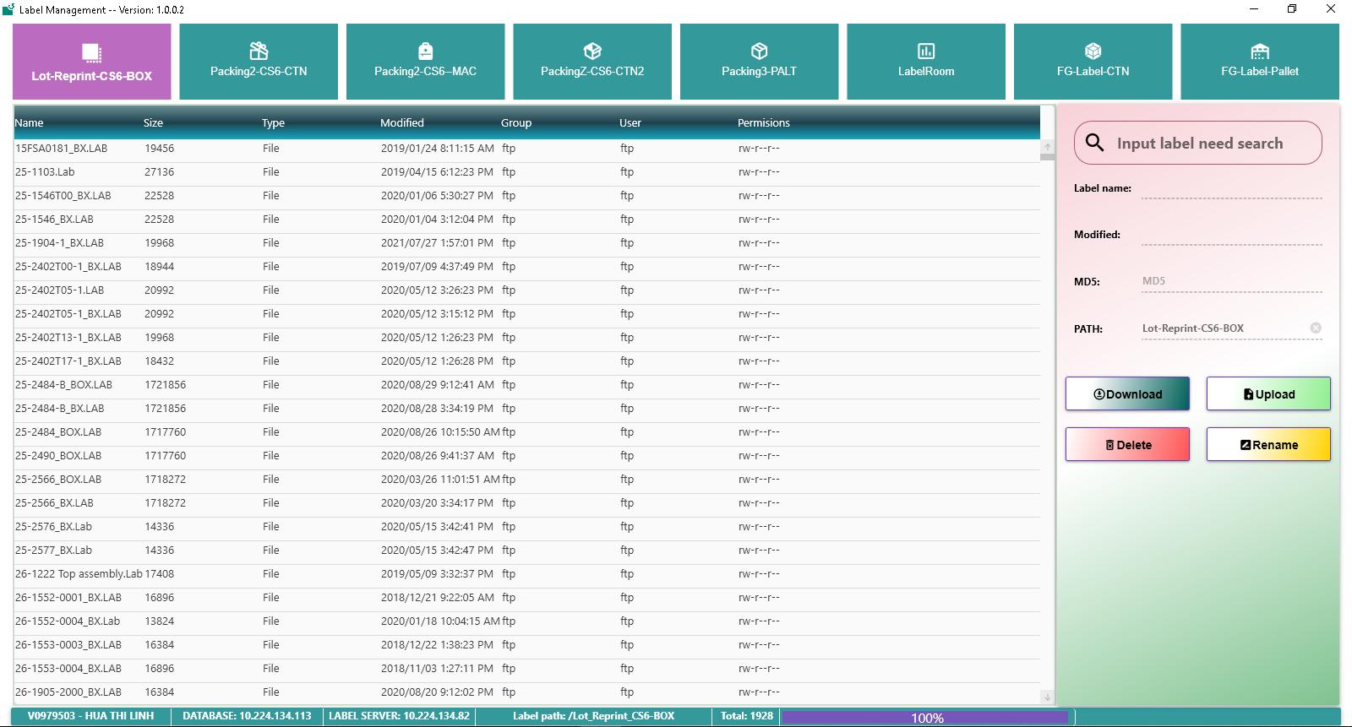
AMS_LABEL BOOK GUIDE
1.MAIN INTERFACE ITEM
1. Label File Library
2. Search label file
3. Menu

Slide 3
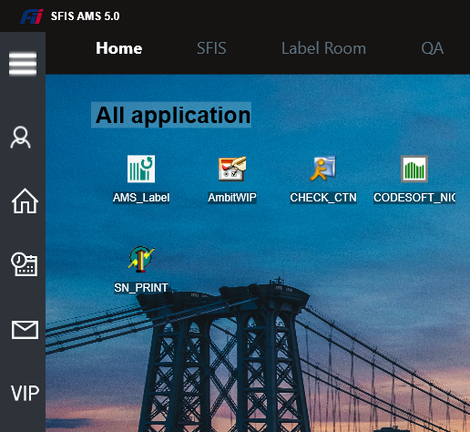
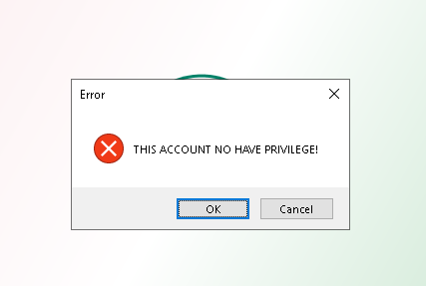
AMS_LABEL BOOK GUIDE
2.LOGIN
Login to SFIS_AMS then double click on AMS_LABEL program.
Login OK
Login NG
If account no have privilege, please contact with IT for permission.

Slide 4
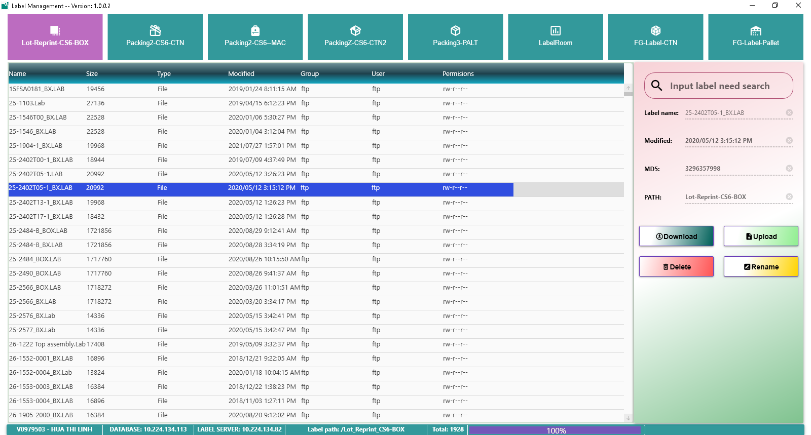
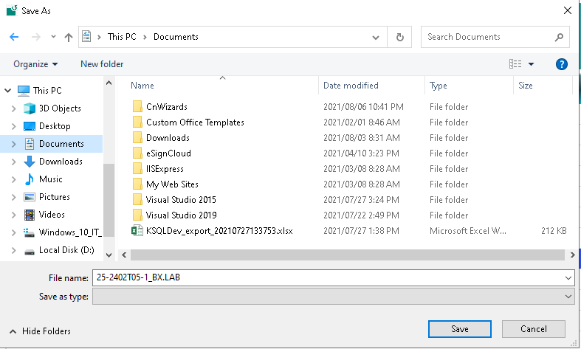
AMS_LABEL BOOK GUIDE
3.DOWLOAD LABEL FILE
4
1
2
3
5
Dowload label file follow step bellow:
Choose type label
Choose label file
Click Dowload
Choose where to save
Click Save

Slide 5
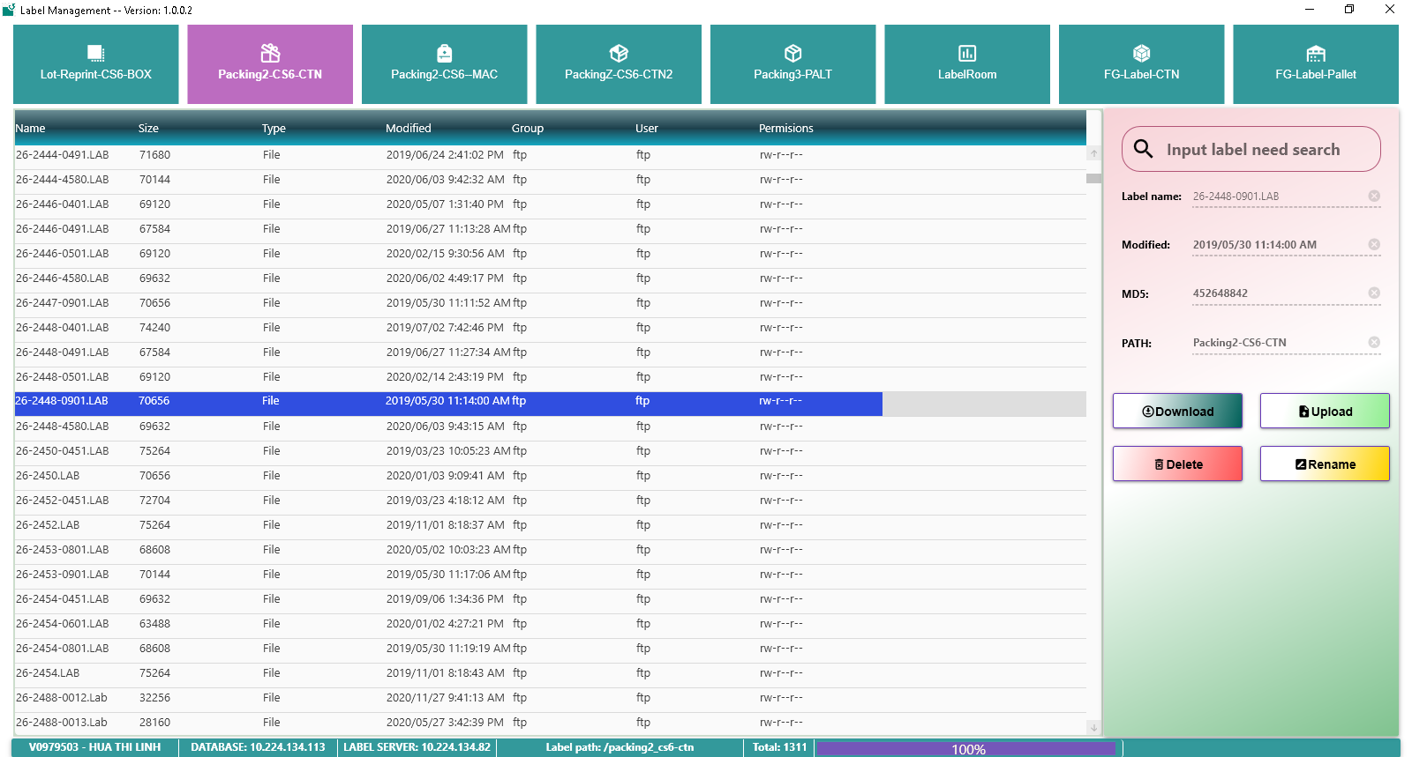
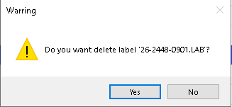
AMS_LABEL BOOK GUIDE
4.DELETE LABEL FILE
1
4
2
Delete label file follow step bellow:
Choose type label
Choose label file
Click Delete
Choose Yes or No to Delete label file
3

Slide 6
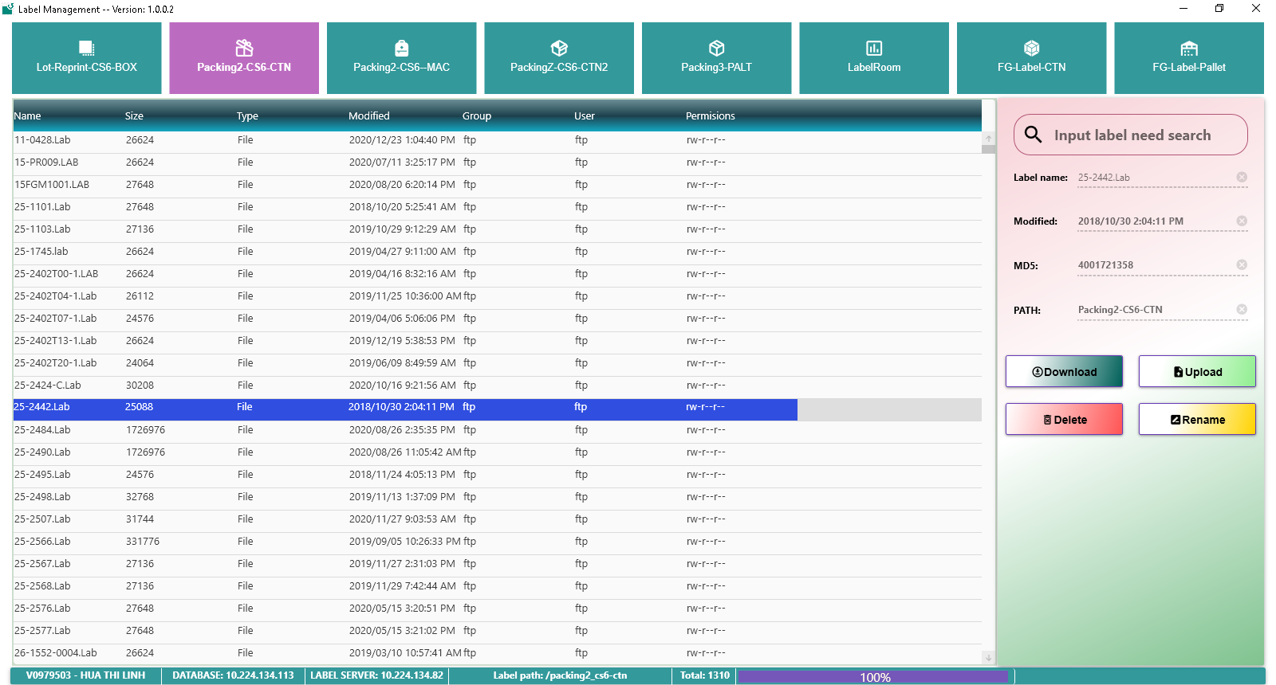
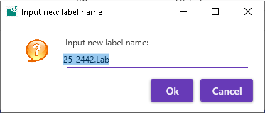
AMS_LABEL BOOK GUIDE
5.RENAME LABEL FILE
1
4
5
2
Rename label file follow step bellow:
Choose type label
Choose label file
Click Rename
Input new label name
Choose OK or Cancel to Rename label file
3

Slide 7
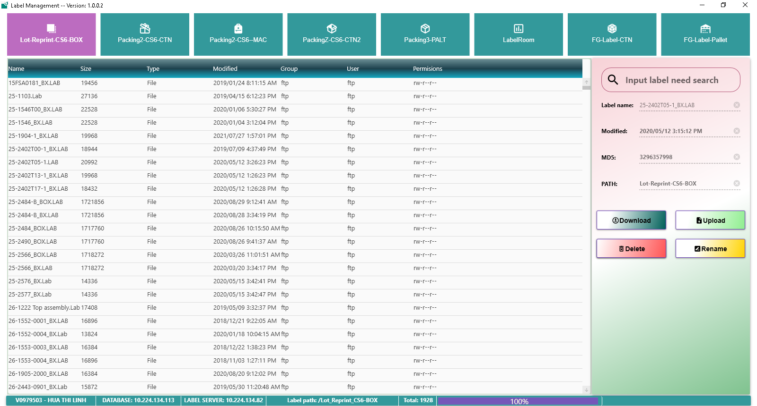
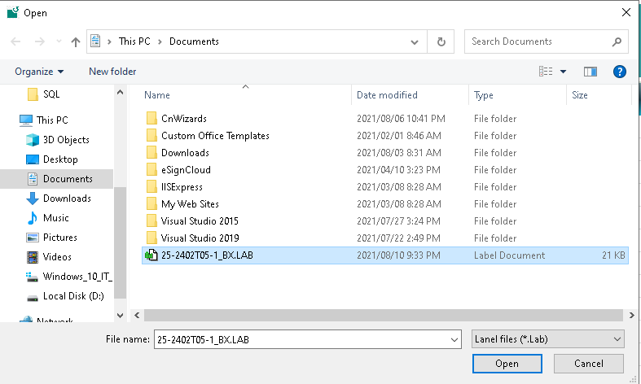
AMS_LABEL BOOK GUIDE
6.UPLOAD LABEL FILE
1
3
2
4
Upload label file follow step bellow:
Choose label type
Click Upload
Choose label file need upload
Choose Open

Slide 8
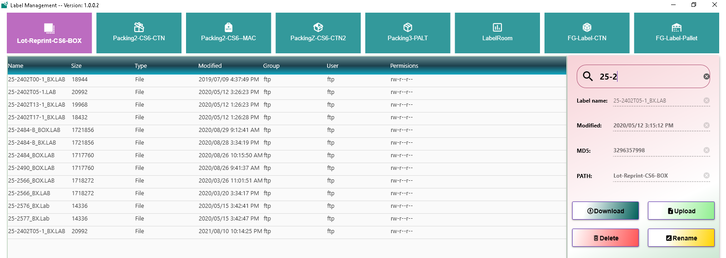
AMS_LABEL BOOK GUIDE
6.UPLOAD LABEL FILE
Label file then upload successful.

Slide 9
AMS_LABEL BOOK GUIDE
THANKS FOR WATCHING

